Slide 1
KEITHSTON
AND PARTNERS
BUSINESS PROPOSAL
PROPOSAL TO: SALFORD CO.
+123-456-7890
www.reallygreatsite.com
hello@reallygreatsite.com

Slide 2
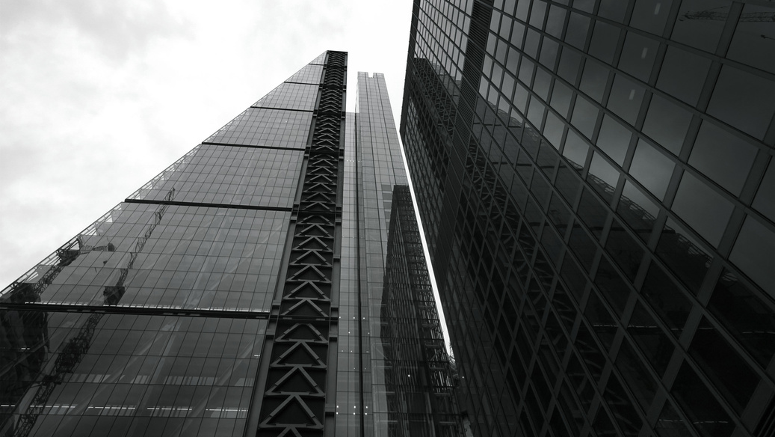
ABOUT US.
A magazine is a periodical publication, which can either be printed or published electronically. It is issued regularly, usually every week or every month, and it contains a variety of content. This can include articles, stories, photographs, and advertisements.
To create your own, choose a topic that interests you. It can be anything from fashion and beauty to travel and the news. Once you have your overall theme, you can start brainstorming the content. Just starting?
Next, think of a compelling feature for your cover story. This will be what draws your audience in. Make sure that you have accompanying visual content that immediately catches the eye. Include photos, illustrations, and other graphics to match.
+123-456-7890
www.reallygreatsite.com
hello@reallygreatsite.com

Slide 3
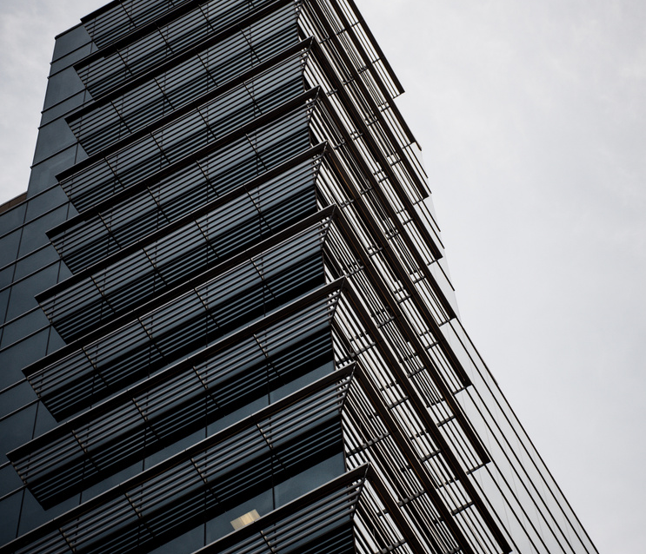
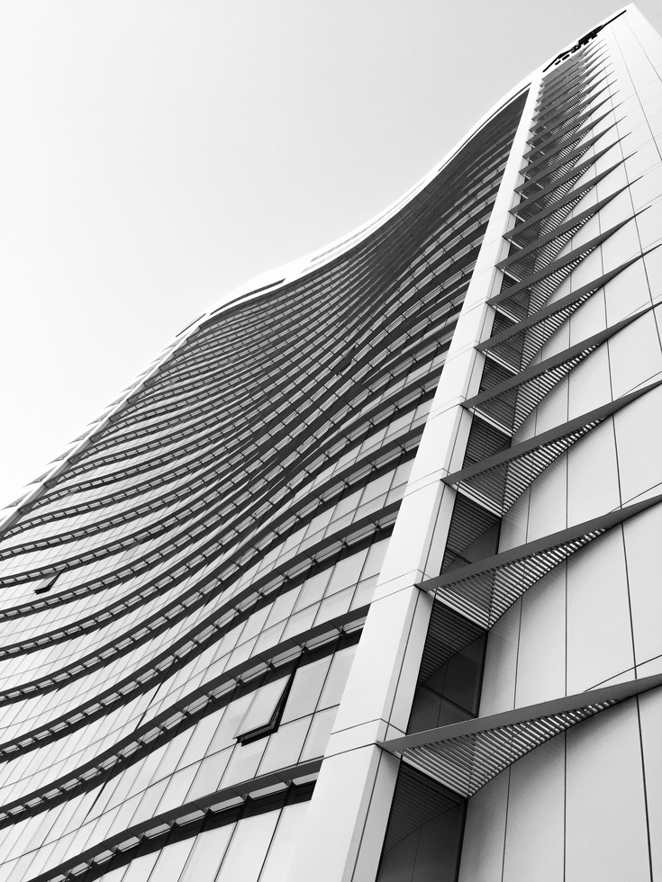
OUR MARKET.
A magazine is a periodical publication, which can either be printed or published electronically. It is issued regularly, usually every week or every month, and it contains a variety of content. This can include articles, stories, photographs, and advertisements.
Next, think of a compelling feature for your cover story. This will be what draws your audience in. Make sure that you have accompanying visual content that immediately catches the eye. Include photos, illustrations, and other graphics to match.
To create your own, choose a topic that interests you. It can be anything from fashion and beauty to travel and the news. Once you have your overall.
+123-456-7890
www.reallygreatsite.com
hello@reallygreatsite.com

Slide 4
OUR MISSION.
A magazine is a periodical publication, which can either be printed or published electronically. It is issued regularly, usually every week or every month, and it contains a variety of content.
This can include articles, stories, photographs, and advertisements. To create your own, choose a topic that interests you. It can be anything from fashion and beauty to travel and the news.
1.
This can include articles, stories, photographs, and advertisements.
2.
It is issued regularly, usually every week or every month.
3.
It can be anything from fashion and beauty to travel and the news.
+123-456-7890
www.reallygreatsite.com
hello@reallygreatsite.com

Slide 5
END OF
PROPOSAL
THANK YOU
+123-456-7890
www.reallygreatsite.com
hello@reallygreatsite.com

